Slide 1
CPT-S 415
Big Data
Yinghui Wu
EME B45

Slide 2
CPT-S 415
Big Data
The veracity of big data
Data quality management: An overview
Central aspects of data quality
  Data consistency
  Entity resolution
  Information completeness
  Data currency
  Data accuracy
  Deducing the true values of objects in data fusion

Slide 3

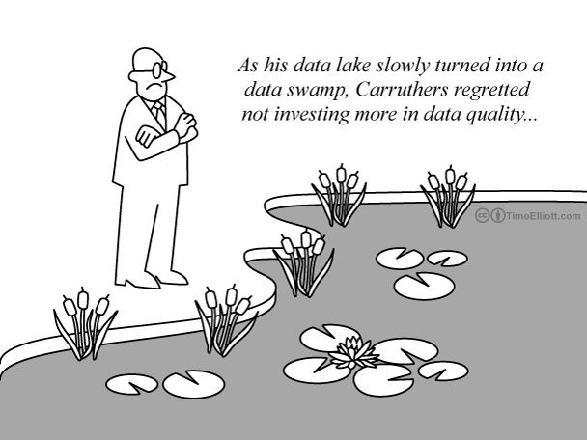
The veracity of big data
When we talk about big data, we typically mean its quantity:
What capacity of a system can cope with the size of the data?
Is a query feasible on big data within our available resources?
How can we make our queries tractable on big data?
Can we trust the answers to our queries in the data?
No, real-life data is typically dirty; you can’t get correct answers to your queries in dirty data no matter how
good your queries are, and
how fast your system is
Big Data = Data Quantity + Data Quality

Slide 4

A real-life encounter
Mr. Smith, our database records indicate that you owe us an outstanding amount of £5,921 for council tax for 2016
NI# | name | AC | phone | street | city | zip
… | … | … | … | … | … | …
SC35621422 | M. Smith | 131 | 3456789 | Crichton | EDI | EH8 9LE
SC35621422 | M. Smith |  | 6728593 |  | LDN | NW1 6XE
020
Baker
Mr. Smith already moved to London in 2015
The council database had not been correctly updated
  both old address and the new one are in the database
50% of bills have errors (phone bill reviews)

Slide 5
Customer records
country | AC | phone | street | city | zip
 |  | 1234567 | Mayfield |  | EH8 9LE
 |  | 3456789 | Crichton |  | EH8 9LE
 |  | 3456789 | Mountain Ave |  | 07974
44
131
New York
44
131
New York
01
908
New York
Anything wrong?
New York City is moved to the UK (country code: 44)
Murray Hill (01-908) in New Jersey is moved to New York state
Error rates: 10% - 75% (telecommunication)

Slide 6





Dirty data are costly
Poor data cost US businesses $611 billion annually
Erroneously priced data in retail databases cost US customers $2.5 billion each year
1/3 of system development projects were forced to delay or cancel due to poor data quality
30%-80% of the development time and budget for data warehousing are for data cleaning
CIA’s World FactBook is extremely dirty!
2000
2001
1998
The scale of the problem is even bigger in big data
Big data = quantity + quality!

Slide 7

Far reaching impact
Telecommunication: dirty data routinely lead to
  failure to bill for services
  delay in repairing network problems
  unnecessary lease of equipment
  misleading financial reports, strategic business planning decision
  loss of revenue, credibility and customers
Finance, life sciences, e-government, …
A longstanding issue for decades
Internet has been increasing the risks, in an unprecedented scale, of creating and propagating dirty data
Data quality: The No. 1 problem for data management

Slide 8


The need for data quality tools
Manual effort: beyond reach in practice
Data quality tools: to help automatically
Repair
  Editing a sample of census data easily took dozens of clerks months (Winkler 04, US Census Bureau)
Detect errors
Reasoning
Discover rules
The market for data quality tools is growing at 17% annually
>> the 7% average of other IT segments
2006

Slide 9

ETL (Extraction, Transformation, Loading)
profiling
transformation
rules
sample
types of errors
data
data
data
for a specific domain, e.g., address data
transformation rules manually designed
low-level programs
  difficult to write
  difficult to maintain
Access data (DB drivers, web page fetch, parsing)
Validate data (rules)
Transform data (e.g. addresses, phone numbers)
Load data
  Hard to check whether these rules themselves are dirty or not
Not very helpful when processing data with rich semantics

Slide 10
Dependencies: A data cleaning approach
Errors found in practice
  Syntactic: a value not in the corresponding domain or range,
  e.g., name = 1.23, age = 250
  Semantic: a value representing a real-world entity different from the true value of the entity
  Dependencies: for specifying the semantics of relational data
  relation (table): a set of tuples (records)
Hard to detect and fix
NI# | name | AC | phone | street | city | zip
SC35621422 | M. Smith | 131 | 3456789 | Crichton | EDI | EH8 9LE
SC35621422 | M. Smith | 020 | 6728593 | Baker | LDN | NW1 6XE
How can dependencies help?

Slide 11
Data consistency

Slide 12
Data inconsistency
The validity and integrity of data
  inconsistencies (conflicts, errors) are typically detected as violations of dependencies
Inconsistencies in relational data
  in a single tuple
  across tuples in the same table
  across tuples in different (two or more relations)
Fix data inconsistencies
  inconsistency detection: identifying errors
  data repairing: fixing the errors
Dependencies should logically become part of data cleaning process

Slide 13
Inconsistencies in a single tuple
country | area-code | phone | street | city | zip
44 | 131 | 1234567 | Mayfield | NYC | EH8 9LE
In the UK, if the area code is 131, then the city has to be EDI
Inconsistency detection:
  Find all inconsistent tuples
  In each inconsistent tuple, locate the attributes with inconsistent values
Data repairing: correct those inconsistent values such that the data satisfies the dependencies
Error localization and data imputation

Slide 14
Inconsistencies between two tuples
NI# → street, city, zip
NI# determines address: for any two records, if they have the same NI#, then they must have the same address
for each distinct NI#, there is a unique current address
NI# | name | AC | phone | street | city | zip
SC35621422 | M. Smith | 131 | 3456789 | Crichton | EDI | EH8 9LE
SC35621422 | M. Smith | 020 | 6728593 | Baker | LDN | NW1 6XE
for SC35621422, at least one of the addresses is not up to date
A simple case of our familiar functional dependencies

Slide 15
Inconsistencies between tuples in different tables
book[asin, title, price] ⊆ item[asin, title, price]
book
asin | isbn | title | price
a23 | b32 | Harry Potter | 17.99
a56 | b65 | Snow white | 7.94
item
asin | title | type | price
a23 | Harry Potter | book | 17.99
a12 | J. Denver | CD | 7.94
Any book sold by a store must be an item carried by the store
  for any book tuple, there must exist an item tuple such that their asin, title and price attributes pairwise agree with each other
Inclusion dependencies help us detect errors across relations

Slide 16
What dependencies should we use?
Dependencies: different expressive power, and different complexity
country | area-code | phone | street | city | zip
44 | 131 | 1234567 | Mayfield | NYC | EH8 9LE
44 | 131 | 3456789 | Crichton | NYC | EH8 9LE
01 | 908 | 3456789 | Mountain Ave | NYC | 07974
functional dependencies (FDs)
  country, area-code, phone → street, city, zip
  country, area-code → city
The database satisfies the FDs, but the data is not clean!
A central problem is how to tell whether the data is dirty or clean
Conditional functional dependencies – new method

Slide 17
Record matching (entity resolution)

Slide 18
Record matching
  To identify records from unreliable data sources that refer to the same real-world entity
FN | LN | address | tel | DOB | gender
Mark | Smith | 10 Oak St, EDI, EH8 9LE | 3256777 | 10/27/97 | M
the same person?
FN | LN | post | phn | when | where | amount
M. | Smith | 10 Oak St, EDI, EH8 9LE | null | 1pm/7/7/09 | EDI | $3,500
… | … | … | … | … | … | …
Max | Smith | PO Box 25, EDI | 3256777 | 2pm/7/7/09 | NYC | $6,300
Record linkage, entity resolution, data deduplication, merge/purge, …

Slide 19


Why bother?
Data quality, data integration, payment card fraud detection, …
Records for card holders
FN | LN | address | tel | DOB | gender
Mark | Smith | 10 Oak St, EDI, EH8 9LE | 3256777 | 10/27/97 | M
fraud?
Transaction records
FN | LN | post | phn | when | where | amount
M. | Smith | 10 Oak St, EDI, EH8 9LE | null | 1pm/7/7/09 | EDI | $3,500
… | … | … | … | … | … | …
Max | Smith | PO Box 25, EDI | 3256777 | 2pm/7/7/09 | NYC | $6,300
World-wide losses in 2006: $4.84 billion

Slide 20
Nontrivial: A longstanding problem
Real-life data are often dirty: errors in the data sources
Data are often represented differently in different sources
FN | LN | address | tel | DOB | gender
Mark | Smith | 10 Oak St, EDI, EH8 9LE | 3256777 | 10/27/97 | M
FN | LN | post | phn | when | where | amount
M. | Smith | 10 Oak St, EDI, EH8 9LE | null | 1pm/7/7/09 | EDI | $3,500
… | … | … | … | … | … | …
Max | Smith | PO Box 25, EDI | 3256777 | 2pm/7/7/09 | NYC | $6,300
Pairwise comparing attributes via equality only does not work!

Slide 21
Challenges
Strike a balance between the efficiency and accuracy
  data files are often large, and quadratic time is too costly
    blocking, windowing to speed up the process
  we want the result to be accurate
    true positive, false positive, true negative, false negative
real-life data is dirty
  We have to accommodate errors in data sources, and moreover, combine data repairing and record matching
matching
  records in the same files
  records in different (even distributed files)
Record matching can also be done based on dependencies

Slide 22
Information completeness

Slide 23
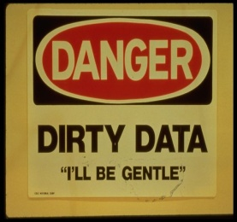
Incomplete information: a central data quality issue
A database D of UK patients: patient (name, street, city, zip, YoB)
A simple query Q1: Find the streets of those patients who
were born in 2000 (YoB), and
live in Edinburgh (Edi) with zip = “EH8 9AB”.
Can we trust the query to find complete & accurate information?
Both tuples and values may be missing from D!
“information perceived as being needed for clinical decisions was unavailable 13.6%--81% of the time” (2006)

Slide 24

Traditional approaches: The CWA vs. the OWA
Real world
The Closed World Assumption (CWA)
  all the real-world objects are already represented by tuples in the database
  missing values only
database
The Open World Assumption (OWA)
  the database is a subset of the tuples representing real-world objects
  missing tuples and missing values
Real world
database
Few queries can find a complete answer under the OWA
None of the CWA or OWA is quite accurate in real life

Slide 25
In real-life applications
Master data (reference data): a consistent and complete repository of the core business entities of an enterprise (certain categories)
CWA
OWA
Master
data
The CWA: the master data – an upper bound of the part constrained
The OWA: the part not covered by the master data
Databases in real world are often
neither entirely closed-world, nor entirely open-world

Slide 26
Partially closed databases
Master data D_{m}: patient_{m}(name, street, zip, YoB)
  Complete for Edinburgh patients with YoB > 1990
Database D: patient (name, street, city, zip, YoB)
  Partially closed:
  D_{m} is an upper bound of Edi patients in D with YoB > 1990
Query Q₁: Find the streets of all Edinburgh patients with YoB = 2000 and zip = “EH8 9AB”.
The seemingly incomplete D has complete information to answer Q₁
if the answer to Q₁ in D returns the streets of all patients p in D_{m}
with p[YoB] = 2000 and p[zip] = “EH8 9AB”.
adding tuples to D does not change its answer to Q1
The database D is complete for Q₁ relative to D_{m}

Slide 27
Making a database relatively complete
Master data: patient_{m}(name, street, zip, YoB)
Partially closed D: patient (name, street, city, zip, YoB)
  D_{m} is an upper bound of all Edi patients in D with YoB > 1990
Query Q₁: Find the streets of all Edinburgh patients with YoB = 2000 and zip = “EH8 9AB”.
The answer to Q1 in D is empty, but D_{m} contains tuples enquired
Adding a single tuple t to D makes it relatively complete for Q₁ if
zip → street is a functional dependency on patient, and
t[YoB] = 2000 and t[zip] = “EH8 9AB”.
Make a database complete relative to master data and a query

Slide 28
Relative information completeness
Partially closed databases: partially constrained by master data; neither CWA nor OWA
Relative completeness: a partially closed database that has complete information to answer a query relative to master data
The completeness and consistency taken together: containment constraints
Fundamental problems:
  Given a partially closed database D, master data D_{m}, and a query Q, decide whether D is complete Q for relatively to D_{m}
  Given master data D_{m} and a query Q, decide whether there exists a partially closed database D that is complete for Q relatively to D_{m}
theory of relative information completeness

Slide 29
Data currency

Slide 30
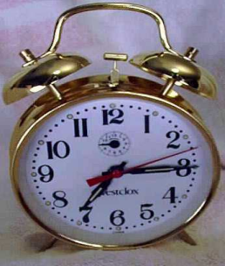
Data currency: another central data quality issue
Data currency: the state of the data being current
Data get obsolete quickly: “In a customer file, within two years about 50% of record may become obsolete” (2002)
Multiple values pertaining to the same entity are present
The values were once correct, but they have become stale and inaccurate
Reliable timestamps are often not available
Identifying stale data is costly and difficult
How can we tell when the data are current or stale?

Slide 31
Determining the currency of data
FN | LN | address | salary | status
Mary | Smith | 2 Small St | 50k | single
Mary | Dupont | 10 Elm St | 50k | married
Mary | Dupont | 6 Main St | 80k | married
Entity:
Mary
Identified via record matching
Q1: what is Mary’s current salary?
80k
Temporal constraint: salary is monotonically increasing
Determining data currency in the absence of timestamps

Slide 32
Dependencies for determining the currency of data
FN | LN | address | salary | status
Mary | Smith | 2 Small St | 50k | single
Mary | Dupont | 10 Elm St | 50k | married
Mary | Dupont | 6 Main St | 80k | married
Q1: what is Mary’s current salary?
80k
currency constraint: salary is monotonically increasing
For any tuples t and t’ that refer to the same entity,
  if t[salary] < t’[salary],
  then t’[salary] is more up-to-date (current) than t[salary]
Reasoning about currency constraints to determine data currency

Slide 33
More on currency constraints
FN | LN | address | salary | status
Mary | Smith | 2 Small St | 50k | single
Mary | Dupont | 10 Elm St | 50k | married
Mary | Dupont | 6 Main St | 80k | married
Q2: what is Mary’s current last name?
Dupont
Marital status only changes from single → married → divorced
For any tuples t and t’, if t[status] = “single” and t’[status] = “married”, then t’ [status] is more current than t[status]
Tuples with the most current marital status also have the most current last name
if t’[status] is more current than t[status], then so is t’[LN] than t’[LN]
Specify the currency of correlated attributes

Slide 34
A data currency model
Data currency model:
  Partial temporal orders, currency constraints
Fundamental problems: Given partial temporal orders, temporal constraints and a set of tuples pertaining to the same entity, to decide
  whether a value is more current than another?
    Deduction based on constraints and partial temporal orders
  whether a value is certainly more current than another?
  no matter how one completes the partial temporal orders, the value is always more current than the other
Deducing data currency using constraints and partial temporal orders

Slide 35
Certain current query answering
Certain current query answering: answering queries with the current values of entities (over all possible “consistent completions” of the partial temporal orders)
Fundamental problems: Given a query Q, partial temporal orders, temporal constraints, a set of tuples pertaining to the same entity, to decide
  whether a tuple is a certain current answer to a query?
    No matter how we complete the partial temporal orders, the tuple is always in the certain current answers to Q
Fundamental problems have been studied; but efficient algorithms are not yet in place
There is much more to be done

Slide 36
Data accuracy

Slide 37
Data accuracy and relative accuracy
data may be consistent (no conflicts), but not accurate
id | FN | LN | age | job | city | zip
12653 | Mary | Smith | 25 | retired | EDI | EH8 9LE
Consistency rule: age < 120. The record is consistent. Is it accurate?
data accuracy: how close a value is to the true value of the entity that it represents?
Relative accuracy: given tuples t and t’ pertaining to the same entity and attribute A, decide whether t[A] is more accurate than t’[A]
Challenge: the true value of the entity may be unknown

Slide 38
Determining relative accuracy
id | FN | LN | age | job | city | zip
12653 | Mary | Smith | 25 | retired | EDI | EH8 9LE
12563 | Mary | DuPont | 65 | retired | LDN | W11 2BQ
Question: which age value is more accurate?
based on context:
for any tuple t, if t[job] = “retired”, then t[age] ≥ 60
65
If we know t[job] is accurate
Dependencies for deducing relative accuracy of attributes

Slide 39
Determining relative accuracy
id | FN | LN | age | job | city | zip
12653 | Mary | Smith | 25 | retired | EDI | EH8 9LE
12563 | Mary | DuPont | 65 | retired | LDN | W11 2BQ
W11 2BQ
Question: which zip code is more accurate?
based on master data:
for any tuples t and master tuple s, if t[id] = s[id], then t[zip] should take the value of s[zip]
Id | zip | convict
12563 | W11 2BQ | no
Master data
Semantic rules: master data

Slide 40
Determining relative accuracy
id | FN | LN | age | job | city | zip
12653 | Mary | Smith | 25 | retired | EDI | EH8 9LE
12563 | Mary | DuPont | 65 | retired | LDN | W11 2BQ
Question: which city value is more accurate?
LDN
based on co-existence of attributes:
for any tuples t and t’,
  if t’[zip] is more accurate than t[zip],
  then t’[city] is more accurate than t[city]
we know that the 2nd zip code is more accurate
Semantic rules: co-existence

Slide 41
Determining relative accuracy
id | FN | LN | age | status | city | zip
12653 | Mary | Smith | 25 | single | EDI | EH8 9LE
12563 | Mary | DuPont | 65 | married | LDN | W11 2BQ
Question: which last name is more accurate?
DuPont
based on data currency:
for any tuples t and t’,
  if t’[status] is more current than t[status],
  then t’[LN] is more accurate than t[LN]
We know “married” is more current than “single”
Semantic rules: data currency

Slide 42
Computing relative accuracy
An accuracy model: dependencies for deducing relative accuracy, and possibly a set of master data
Fundamental problems: Given dependencies, master data, and a set of tuples pertaining to the same entity, to decide
  whether an attribute is more accurate than another?
  compute the most accurate values for the entity
  . . .
Reading: Determining the relative accuracy of attributes, SIGMOD 2013
Deducing the true values of entities

Slide 43
Putting things together

Slide 44
Dependencies for improving data quality
The five central issues of data quality can all be modeled in terms of dependencies as data quality rules
We can study the interaction of these central issues in the same logic framework
  we have to take all five central issues together
  These issues interact with each other
    data repairing and record matching
    data currency, record matching, data accuracy,
    …
More needs to be done: data beyond relational, distributed data, big data, effective algorithms, …
A uniform logic framework for improving data quality

Slide 45




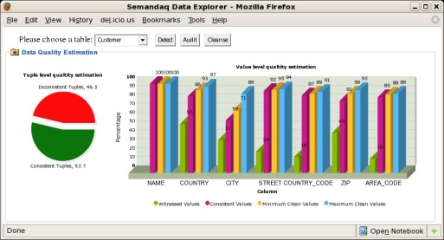
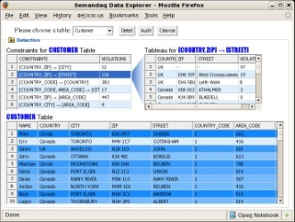

Improving data quality with dependencies
Business rules
Master data
Profiling
Cleaning
Record matching
Validation
dependencies
standardization
automatically
discover rules
data currency
data enrichment
data accuracy
monitoring
Dirty data
Clean Data
data explorer
Duplicate Payment Detection
Customer Account Consolidation
example
applications
Credit Card Fraud Detection
…

Slide 46
Opportunities
Look ahead: 2-3 years from now
Big data collection: to accumulate data
Assumption: the data collected must be of high quality!
Data quality and data fusion systems
Applications on big data – to make use of big data
Without data quality systems, big data is not much of practical use!
“After 2-3 years, we will see the need for data quality systems substantially increasing, in an unprecedented scale!”
Big challenges, and great opportunities

Slide 47
Challenges
Data quality: The No.1 problem for data management
dirty data is everywhere: telecommunication, life sciences, finance, e-government, …; and dirty data is costly!
data quality management is a must for coping with big data
The study of data quality has been, however, mostly focusing on relational databases that are not very big
  How to detect errors in data of graph structures?
  How to identify entities represented by graphs?
  How to detect errors from data that comes from a large number of heterogeneous sources?
  Can we still detect errors in a dataset that is too large even for a linear scan?
  After we identify errors in big data, can we efficiently repair the data?
The study of data quality is still in its infancy

Slide 48
Summary and Review
Why do we have to worry about data quality?
What is data consistency? Give an example
What is data accuracy?
What does information completeness mean?
What is data currency (timeliness)?
What is entity resolution? Record matching? Data deduplication?
What are central issues for data quality? How should we handle these issues?
What are new challenges introduced by big data to data quality management?

Slide 49
Reading list
W. Fan, F. Geerts, X. Jia and A. Kementsietsidis. Conditional Functional Dependencies for Capturing Data Inconsistencies, TODS, 33(2), 2008.
L. Bravo, W. Fan. S. Ma. Extending dependencies with conditions. VLDB 2007.
W. Fan, J. Li, X. Jia, and S. Ma. Dynamic constraints for record matching, VLDB, 2009.
L. E. Bertossi, S. Kolahi, L.Lakshmanan: Data cleaning and query answering with matching dependencies and matching functions, ICDT 2011. http://people.scs.carleton.ca/~bertossi/papers/matchingDC-full.pdf
F. Chiang and M. Miller, Discovering data quality rules, VLDB 2008. http://dblab.cs.toronto.edu/~fchiang/docs/vldb08.pdf
L. Golab, H. J. Karloff, F. Korn, D. Srivastava, and B. Yu, On generating near-optimal tableaux for conditional functional dependencies, VLDB 2008. http://www.vldb.org/pvldb/1/1453900.pdf

Slide 50
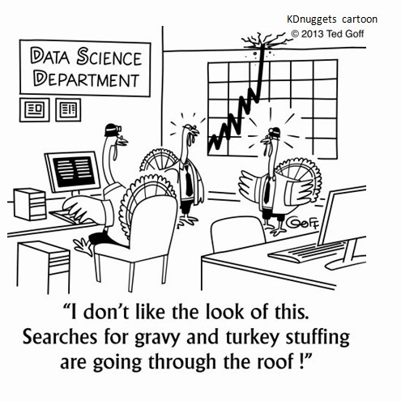
… and Happy Thanksgiving!

